Slide 1
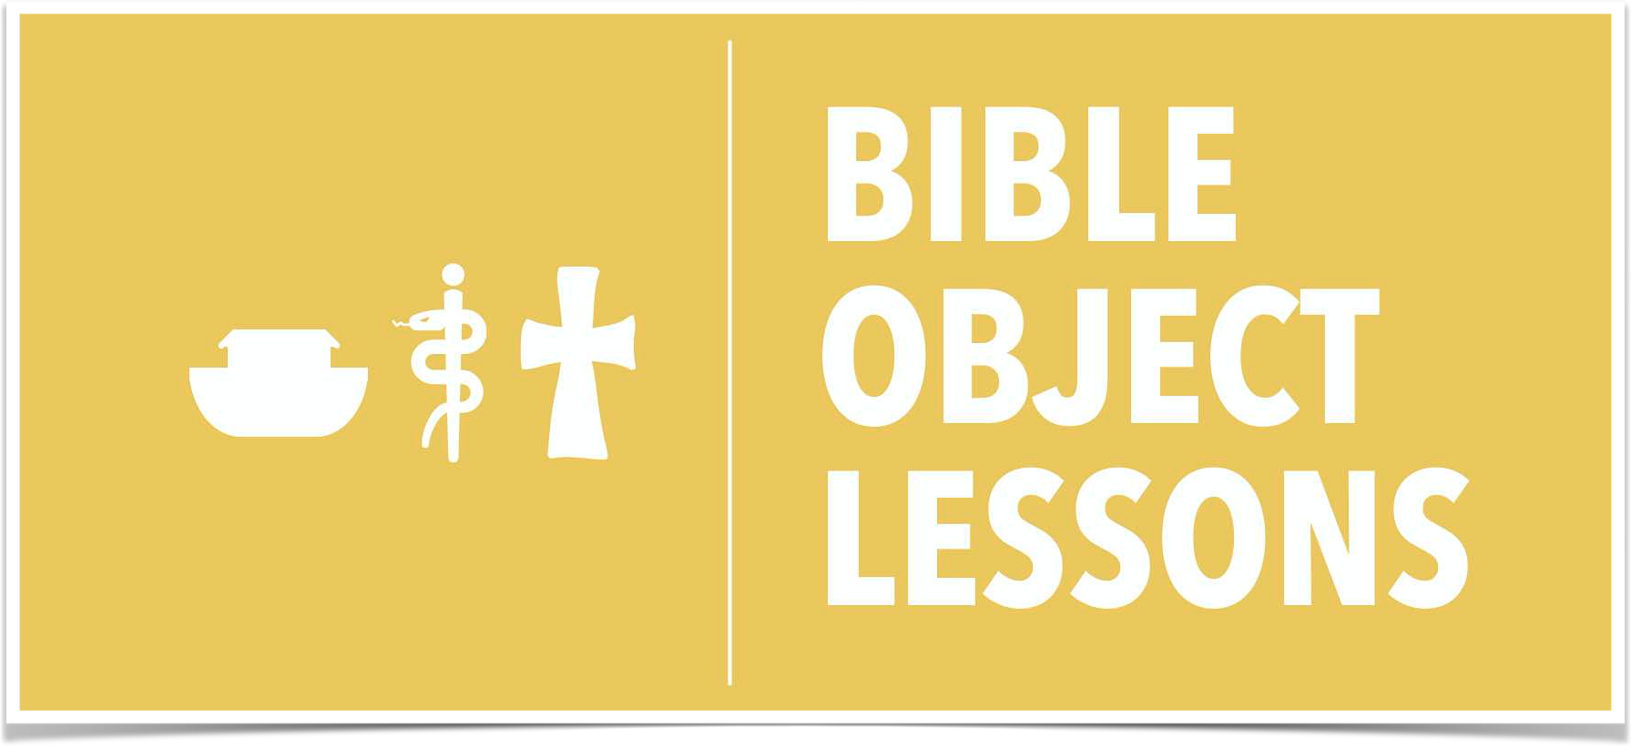
The Temple and Tabernacle
Ps Clive Dorrington
Bible Object Lessons
17 February

Slide 2
Lesson Overview
The Ritual Objects
The Tabernacle of Moses
Solomon’s Temple
Zerubbabel’s Temple
Herod’s Temple
Ezekiel’s Temple

Slide 3
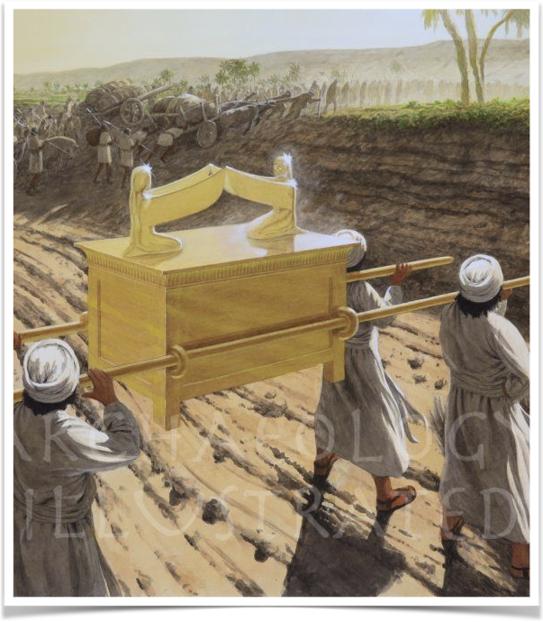
Ritual Objects
Altar of Incense
  Exodus 30:1-10
Lamp Stand
  Exodus 25:31-40
Table of Bread of Presence
  Exodus 25:23-30
  2 Samual 21:4
Ark of the Covenant
  Exodus 25:10-22
Bronze Altar
  Exodus 27:1-8
https://archaeologyillustrated.com

Slide 4
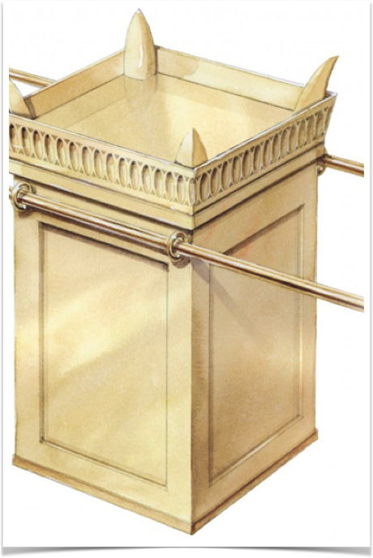
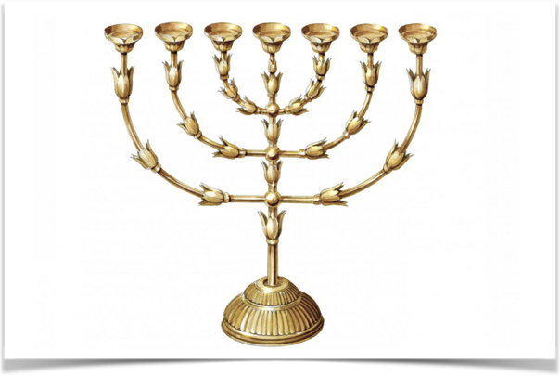
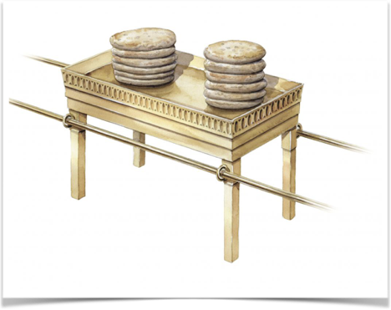
ESV Global Study Bible Kindle Edition

Slide 5
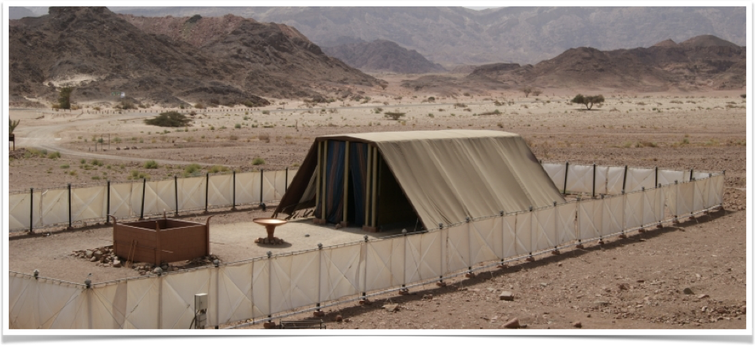
The Tabernacle
Exodus 26 Construction of the Tabernacle

Slide 6
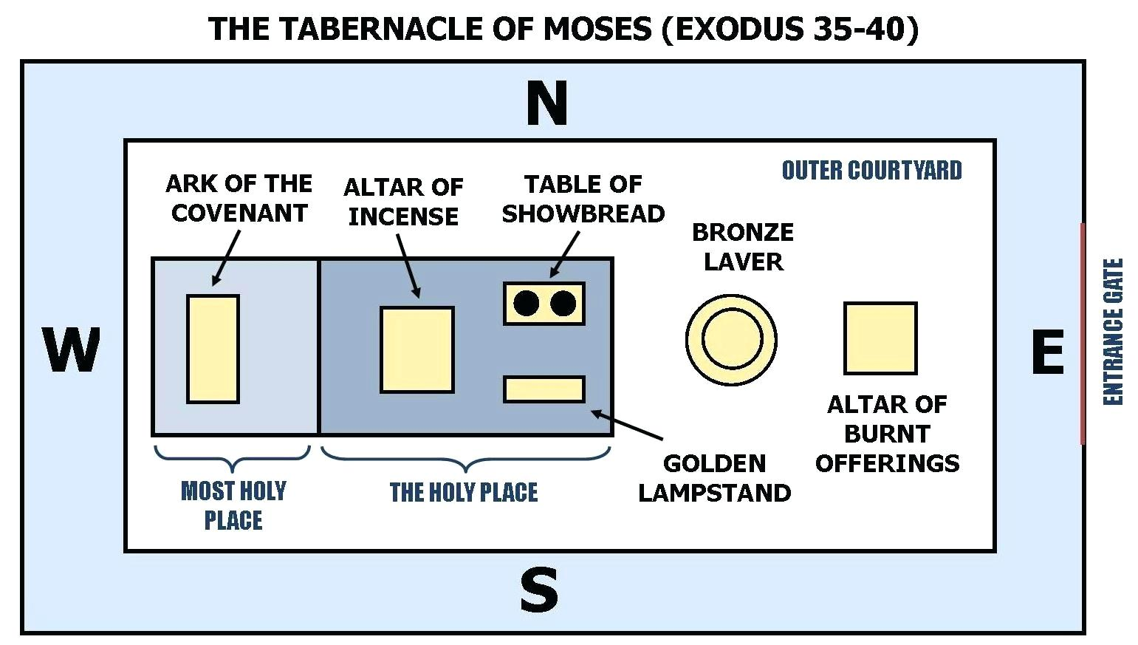

Slide 7
1 Moreover thou shalt make the tabernacle with ten curtains of fine twined linen, and blue, and purple, and scarlet: with cherubims of cunning work shalt thou make them.
2 The length of one curtain shall be eight and twenty cubits, and the breadth of one curtain four cubits: and every one of the curtains shall have one measure.
3 The five curtains shall be coupled together one to another; and other five curtains shall be coupled one to another.
4 And thou shalt make loops of blue upon the edge of the one curtain from the selvedge in the coupling; and likewise shalt thou make in the uttermost edge of another curtain, in the coupling of the second.
– Exodus 26:1-4 KJV

Slide 8
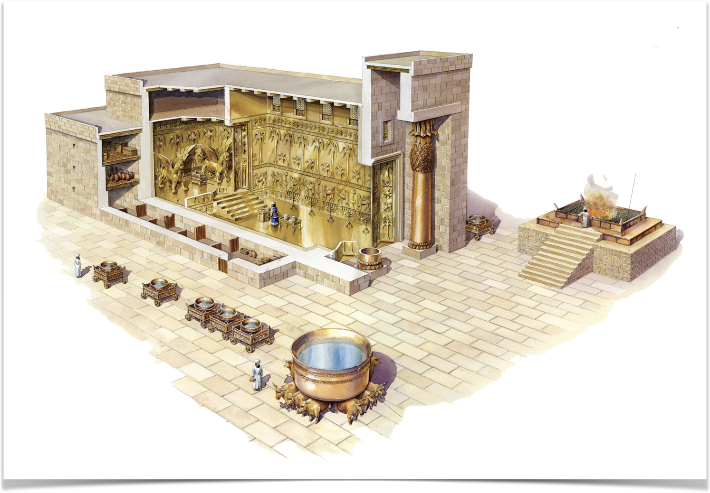
Solomon’s Temple
1 Kings 6 How it what built
2 Chronicles 3 where it was built

Slide 9
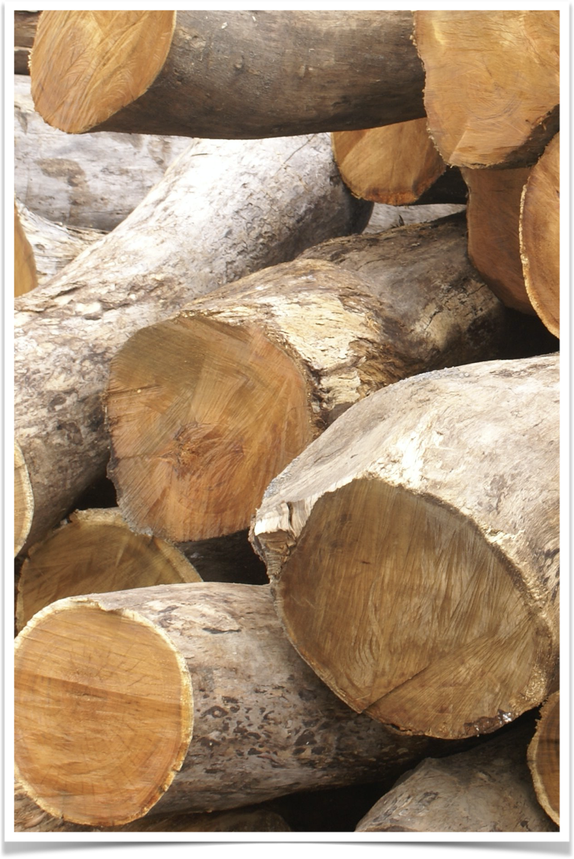
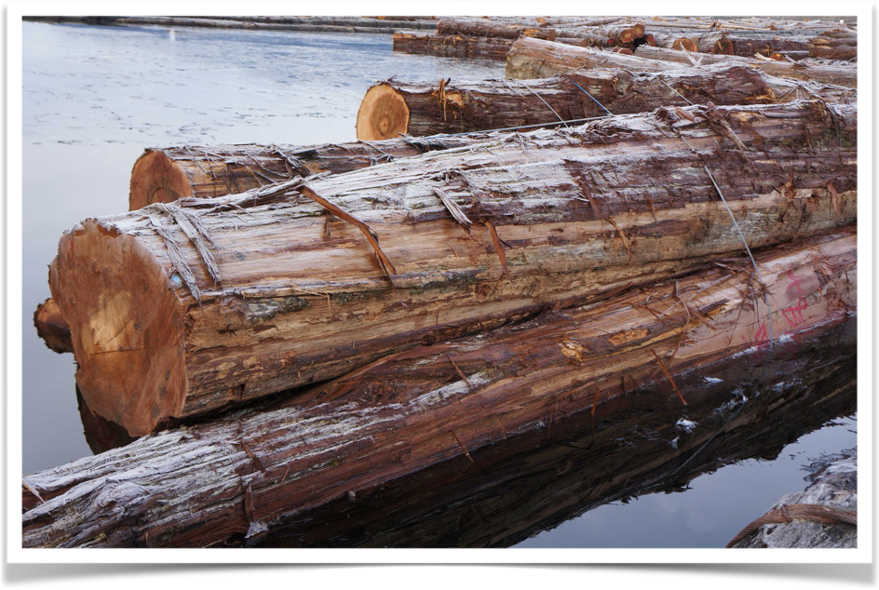
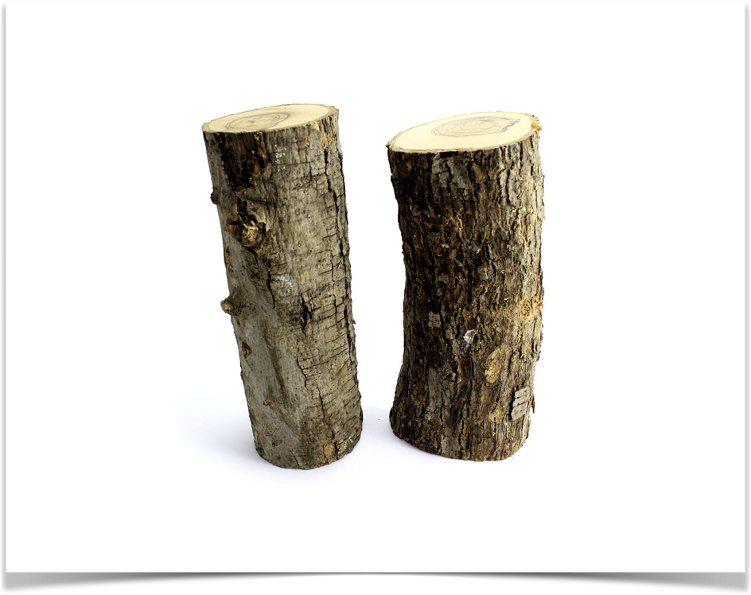

Slide 10
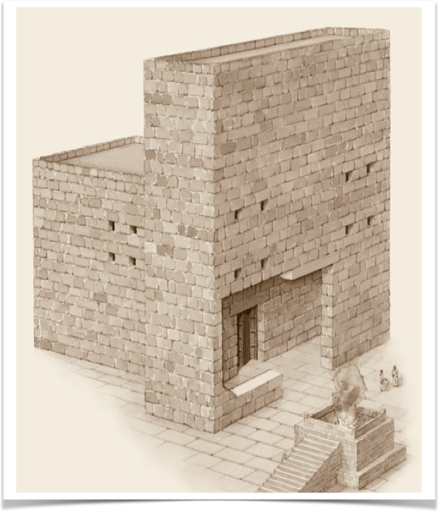
Zerubbabel’s Temple
Ezra 3 Construction process
Ezra 6:3 Dimensions

Slide 11
But many of the priests and Levites and chief of the fathers, who were ancient men, that had seen the first house, when the foundation of this house was laid before their eyes, wept with a loud voice; and many shouted aloud for joy:
So that the people could not discern the noise of the shout of joy from the noise of the weeping of the people: for the people shouted with a loud shout, and the noise was heard afar off.
Ezra 3:12-13

Slide 12
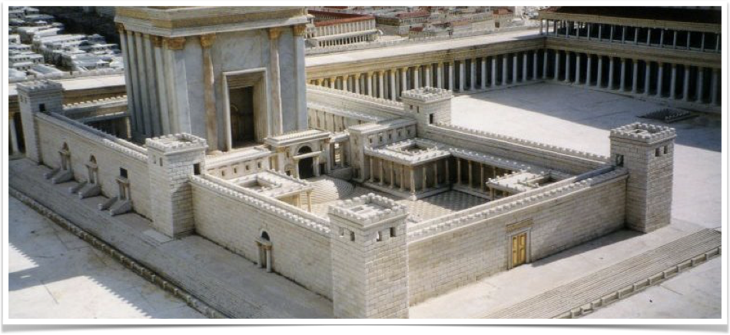
Herod’s Temple
https://www.realmofhistory.com/2017/11/14/animation-reconstruction-second-temple-jerusalem/
Luke 1:11 Vision of angel
Luke 23:45 veil torn
Mark 13:1-2 destruction foretold

Slide 13
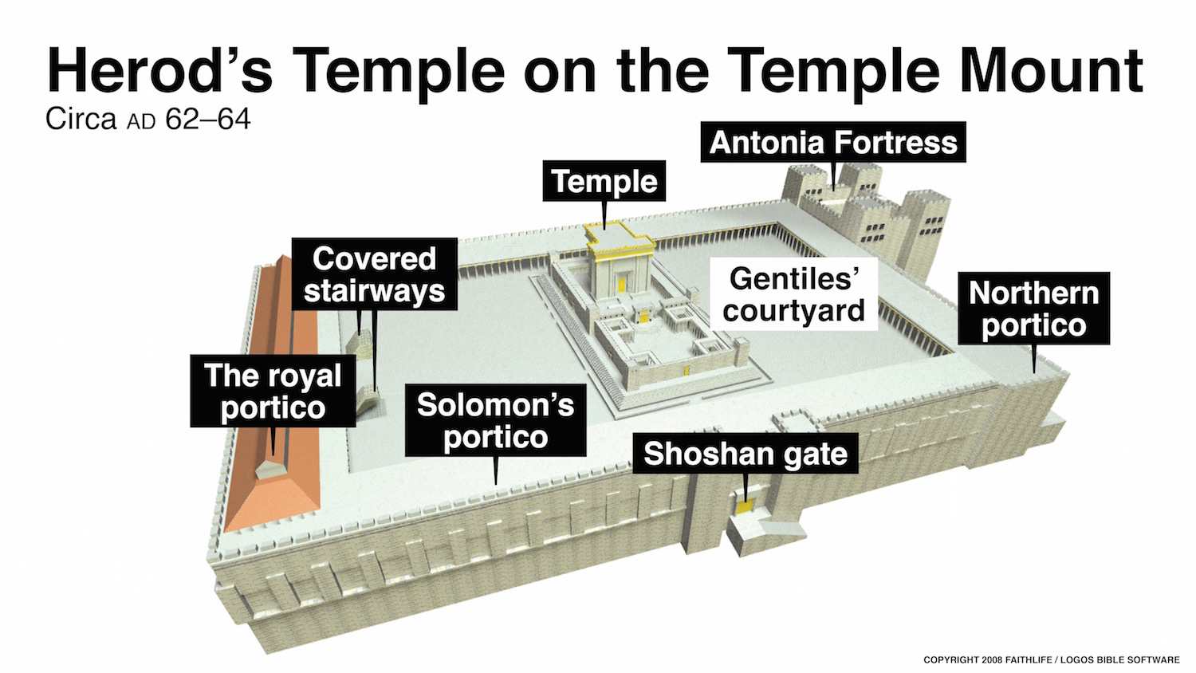

Slide 14
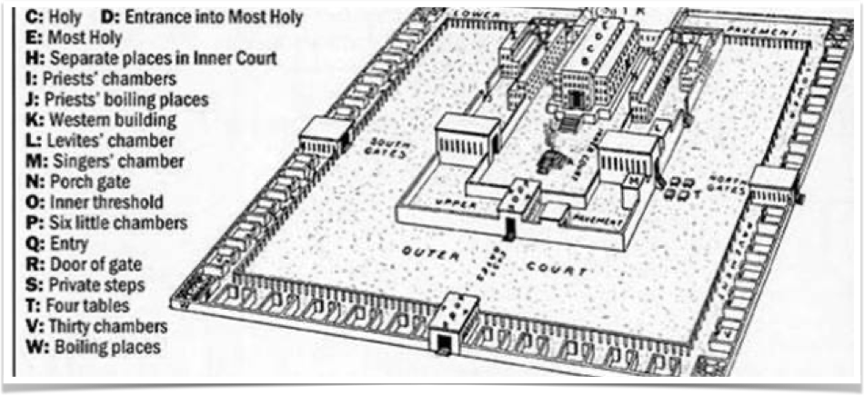
Ezekiel’s Temple
Ezekiel 40-42 describes massive new temple
43-48 describes many events surrounding this coming temple

Slide 15
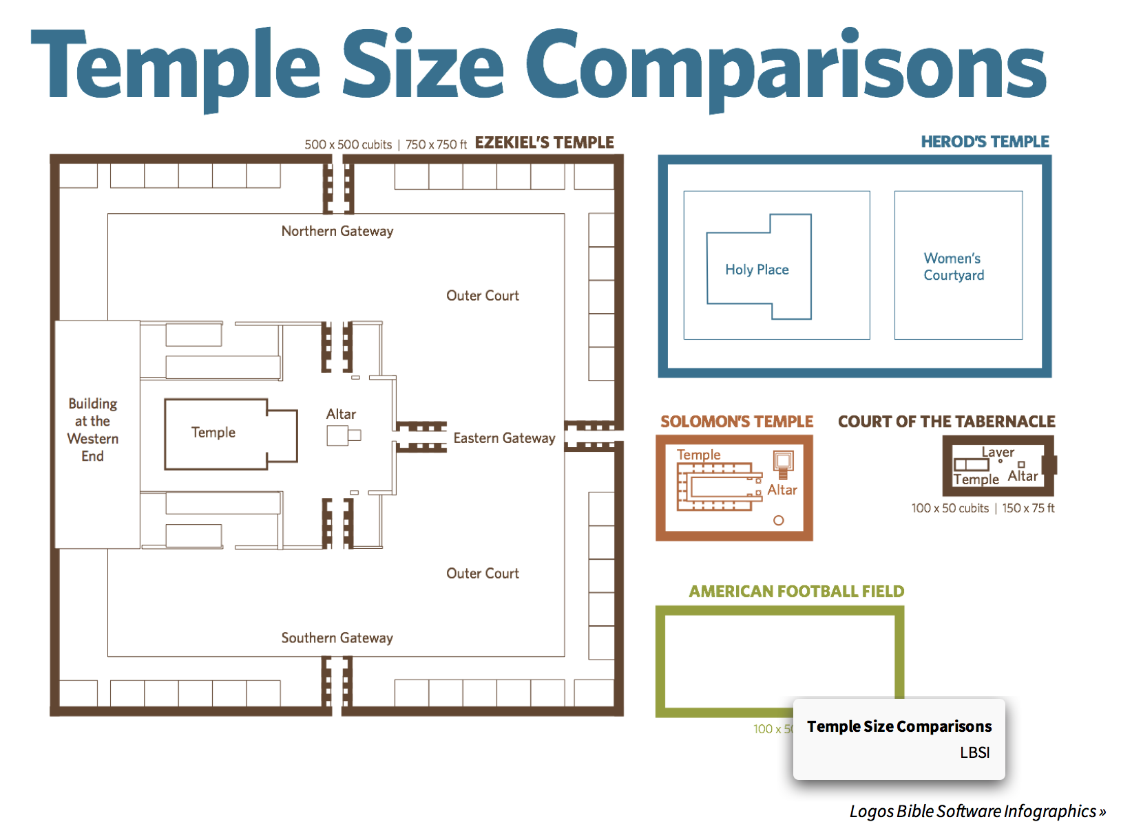

Slide 16
How can this help me read my bible?
In Hebrews 9 we see the temple, Holy place, and sacrificial rituals are are meant to picture Christ.
  Hebrews 9
  7 But into the second went the high priest alone once every year, not without blood, which he offered for himself, and for the errors of the people: 8 The Holy Ghost this signifying, that the way into the holiest of all was not yet made manifest, while as the first tabernacle was yet standing

Slide 17
It adds understanding to narratives such as the Gospels. Many encounters took place at the temple and Jesus used it in his illustrations.
  John 3
  19 Jesus answered and said unto them, Destroy this temple, and in three days I will raise it up. 20 Then said the Jews, Forty and six years was this temple in building, and wilt thou rear it up in three days? 21 But he spake of the temple of his body.

Slide 18
There is a lot of rich teachings about God (theology) surrounding the temple such as His holiness and glory, to name just one example.
  Isaiah 6
  In the year that king Uzziah died I saw also the Lord sitting upon a throne, high and lifted up, and his train filled the temple. 2 Above it stood the seraphims: each one had six wings; with twain he covered his face, and with twain he covered his feet, and with twain he did fly. 3 And one cried unto another, and said, Holy, holy, holy, is the Lord of hosts: the whole earth is full of his glory.

Slide 19
Bible Object Lessons Scope and Sequence
Objects of Salvation
  The ark of Noah, the atonement sacrifice, the serpents on the rod, the Roman crucifixion
Ancient cities
  How they were built dn operated, Jerusalem in David’s time, Jerusalem in Jesus’ time, Capernaum, and Babylon.
Roads, religion and running water
  A geography lesson on ancient middle east and Asia, the river of Jordan, Mediterranean Sea and Pauls missionary journey, and the Judean wilderness.

Slide 20
Thank you
Ps Clive Dorrington

